Slide 1

Predicting Diabetes with Machine Learning on CDC Health Indicators Dataset

Slide 2

Presentation Overview
1
Introduction
2
Dataset & Preprocessing
Research context and objectives for diabetes prediction using machine learning
Data collection methodology and preparation steps for model training
3
Feature Selection & Class Balancing
4
Model Implementation
Key variable identification and techniques to address data imbalance
Machine learning algorithms and ensemble methods applied to the dataset
5
Results & Evaluation
6
Recommendations & Conclusion
Performance metrics and comparative analysis of different models
Key findings, clinical implications, and future research directions

Slide 3

Diabetes: A Growing Health Challenge
Diabetes continues to be a major global public health concern, with increasing prevalence and significant socio-economic implications. Early and accurate detection is paramount for effective management and improved patient outcomes.

Slide 4



Project Objectives: Enhancing Predictive Capabilities
Classify Individuals
Identify Key Predictors
Support Public Health
Accurately classify individuals into healthy, pre-diabetic, or diabetic categories.
Determine significant machine learning features that predict diabetes risk.
Provide actionable insights for early intervention and targeted public health strategies.

Slide 5
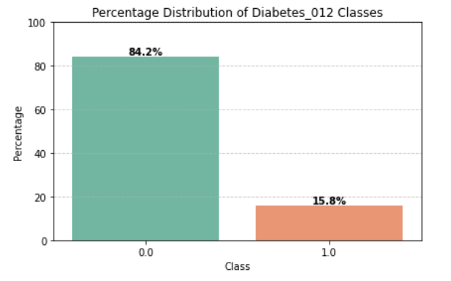
Dataset Overview: CDC BRFSS 2015
The CDC BRFSS 2015 dataset comprises 21 distinct features, encompassing critical health indicators such as Body Mass Index (BMI), Age, and General Health (GenHlth).
This dataset exhibits a clean structure with no missing values, featuring a diverse mix of binary and continuous data types. However, a significant challenge identified is the pronounced imbalance within the target class distribution, which necessitates careful handling during model training.
No Diabetes
Pre-diabetic
Diabetic
The dataset comprises 253,680 entries and 21 distinct features, offering a robust foundation for predictive modeling.

Slide 6




Data Preprocessing Pipeline
Missing Value Handling
Encoding & Scaling
The dataset had no missing values, simplifying the initial cleaning phase.
Categorical features were encoded, and numerical features were scaled to ensure uniformity.
SMOTE Application
Train-Test Split
Synthetic Minority Over-sampling Technique (SMOTE) was applied to address class imbalance, specifically on the training data.
The dataset was partitioned into 80% training and 20% testing sets for model validation.

Slide 7
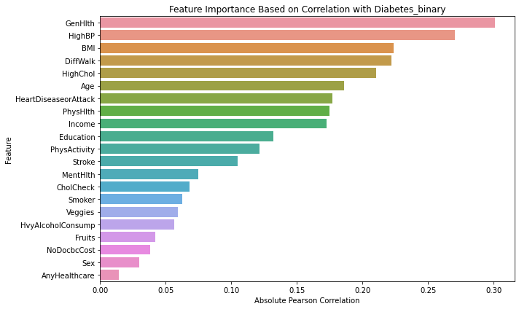
Advanced Feature Selection Techniques
To enhance model performance and interpretability, we employed a combination of sophisticated feature selection methodologies.
Recursive Feature Elimination (RFE)
Tree-based Importance
SHAP Values
SHAP (SHapley Additive exPlanations) values provided model-agnostic insights into feature contributions.
Feature importance scores derived from Random Forest and XGBoost models were used to rank features.
RFE was utilised with a Logistic Regression estimator to iteratively remove less important features.

Slide 8
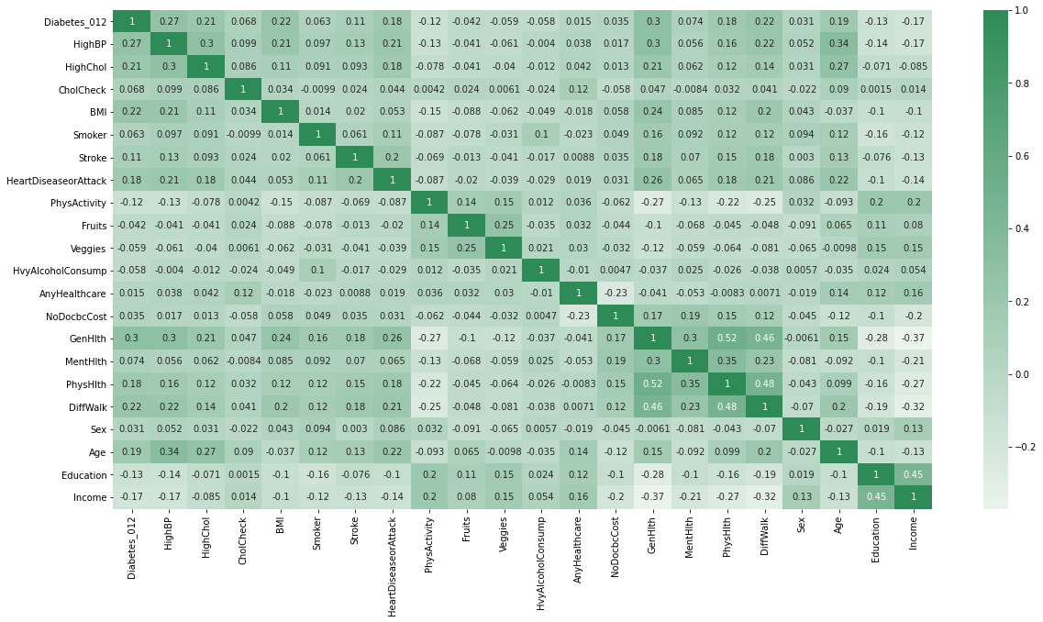
Correlation Insights
Understanding the interrelationships between features and the target variable is crucial for effective model development. Our analysis revealed several notable correlations with diabetes presence.
Positive Correlations
Negative Correlations
GenHlth: Poorer self-reported general health strongly correlates with higher diabetes risk.
Income: Higher income levels are associated with a lower prevalence of diabetes.
DiffWalk: Difficulty walking or climbing stairs is a significant indicator.
Education: Increased educational attainment shows a negative correlation.
HighBP: Individuals with high blood pressure show a positive correlation.
Veggies: Regular consumption of vegetables is inversely correlated with diabetes risk.
Age: As age increases, so does the likelihood of diabetes.

Slide 9




Machine Learning Models Employed
A diverse set of machine learning algorithms were selected and rigorously evaluated to identify the most effective predictive model for diabetes classification.
Logistic Regression
Decision Tree
A foundational statistical model for binary classification, providing a strong baseline.
A non-parametric supervised learning method used for classification and regression.
Random Forest
XGBoost
An ensemble learning method that builds multiple decision trees for improved accuracy and robustness.
A highly efficient and powerful gradient boosting framework, known for its performance.

Slide 10
Model Performance Comparison
A comparative analysis of the evaluation metrics reveals the strengths and weaknesses of each machine learning
model in predicting diabetes.
Model | Accuracy | Precision | Recall | F1-score
Logistic Regression | 0.87 | 0.90 | 0.83 | 0.86
Decision Tree | 0.88 | 0.95 | 0.79 | 0.86
Random Forest | 0.89 | 0.96 | 0.81 | 0.88
XGBoost | 0.87 | 0.87 | 0.87 | 0.87
Logistic Regression
Decision Tree
Random Forest
XGBoost
XGBoost consistently demonstrates superior performance across all metrics, indicating its robustness in handling the complexities of the dataset.

Slide 11
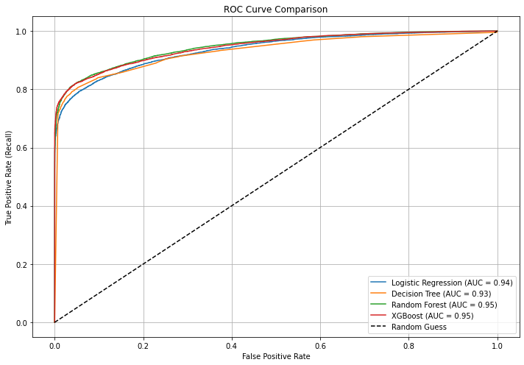
ROC Curves & AUC Analysis
Receiver Operating Characteristic (ROC) curves provide a visual representation of the trade-off between the true positive rate and the false positive rate at various threshold settings.
The Area Under the Curve (AUC) values further quantify the models' ability to distinguish between diabetic and non-diabetic individuals.
Logistic Regression AUC : 0.94
Decision Tree AUC : 0.93
Random Forest AUC : 0.95
XGBoost AUC : 0.95
XGBoost's highest AUC value signifies its exceptional discriminatory power.

Slide 12
Conclusion And Recommendations
1
2
3
Enhanced Accuracy with ML
Superior Ensemble Models
Validated Medical Indicators
Machine learning offers a precise and effective approach to predicting diabetes, validated by this study.
Random Forest and XGBoost models consistently delivered superior predictive performance.
Feature importance aligned with established medical indicators, reinforcing model reliability.
4
5
Improved Detection with SMOTE
Future Clinical Integration
SMOTE significantly improved the detection of diabetic cases, especially for underrepresented groups.
Next steps involve real-time clinical deployment and exploring deep learning for further accuracy.

Slide 13
References
Pedregosa, F., Varoquaux, G., Gramfort, A., Michel, V., Thirion, B., Grisel, O., ... & Duchesnay, É. (2011). Scikit-learn: Machine learning in Python. Journal of Machine Learning Research, 12, 2825–2830. https://jmlr.csail.mit.edu/papers/v12/pedregosa11a.html
Chen, T., & Guestrin, C. (2016). XGBoost: A scalable tree boosting system. In Proceedings of the 22nd ACM SIGKDD International Conference on Knowledge Discovery and Data Mining (pp. 785–794). https://doi.org/10.1145/2939672.2939785
Hastie, T., Tibshirani, R., & Friedman, J. (2009). The elements of statistical learning: Data mining, inference, and prediction (2nd ed.). Springer. https://doi.org/10.1007/978-0-387-84858-7
Géron, A. (2019). Hands-on machine learning with Scikit-Learn, Keras, and TensorFlow (2nd ed.). O'Reilly Media.

Slide 14
THANK YOU

